Slide 1
Challenges in Reporting and Staging of Colorectal Carcinoma
Raul S. Gonzalez, MD
Emory University Hospital

Slide 2
Disclosure of Relevant Financial Relationships
I have done consulting work for
  Astellas Pharma Inc
  Bristol Myers Squibb
  GlaxoSmithKline
  Vertex Pharmaceuticals
No information related to these activities will be discussed in this talk
RDC Nº 96/08 da ANVISA

Slide 3




Slide 4

Survey

Slide 5
Outline
Case 1 – challenges in T-category staging (no neoadjuvant tx)
Case 2 – challenges in T-category staging (neoadjuvant tx)
Case 3 – challenges in N-category staging
Case 4 – more challenges in N-category staging
Even more in N-category staging
Other challenges in synoptic reporting

Slide 6
AJCC 8th Edition Staging for Colon Cancer
pTis: Carcinoma in situ
pT1: Invasion of submucosa
pT2: Invasion of muscularis propria
pT3: Invasion of pericolorectal tissue (including subserosa)
pT4a: Invasion of visceral peritoneum
pT4b: Direct invasion into/adherence to other structures

Slide 7
AJCC 8th Edition Staging for Colon Cancer
pN0: 0 nodes involved
pN1a: 1 node involved (tumor measuring >0.2 mm)
pN1b: 2-3 nodes involved
pN1c: Tumor deposits and no nodes involved
pN2a: 4-6 nodes involved
pN2b: >6 nodes involved

Slide 8
AJCC 8th Edition Staging for Colon Cancer
pM0: No distant metastasis (not a pathologist determination)
pM1a: Metastasis to 1 distant site/organ, no peritoneal mets
pM1b: Metastasis to >1 distant site/organ, no peritoneal mets
pM1c: Peritoneal mets, +/- distant mets

Slide 9
Why Does Staging Matter?
Stage I (pT2N0 or better) – probably no adjuvant therapy
Stage IIB-IVC (pT4aN0 or worse) – probably adjuvant therapy
Stage IIA (pT3N0) – the area of uncertainty
Any adverse risk factors? LVI, PNI, high-grade, tumor budding, perforation, etc.

Slide 10
Case 1
An untreated colorectal carcinoma extends to within 1 mm of the serosal surface. There is inflammation and fibrosis between the tumor and the serosal surface.
Should this be staged as pT3 or pT4a?

Slide 11
pT3 and pT4 – so close, yet so far
CRC may extend to within 1 mm of serosal surface, sometimes with accompanying inflammatory reaction
Unclear whether this should be considered serosal disease or not
Several studies have indicated no

Slide 12

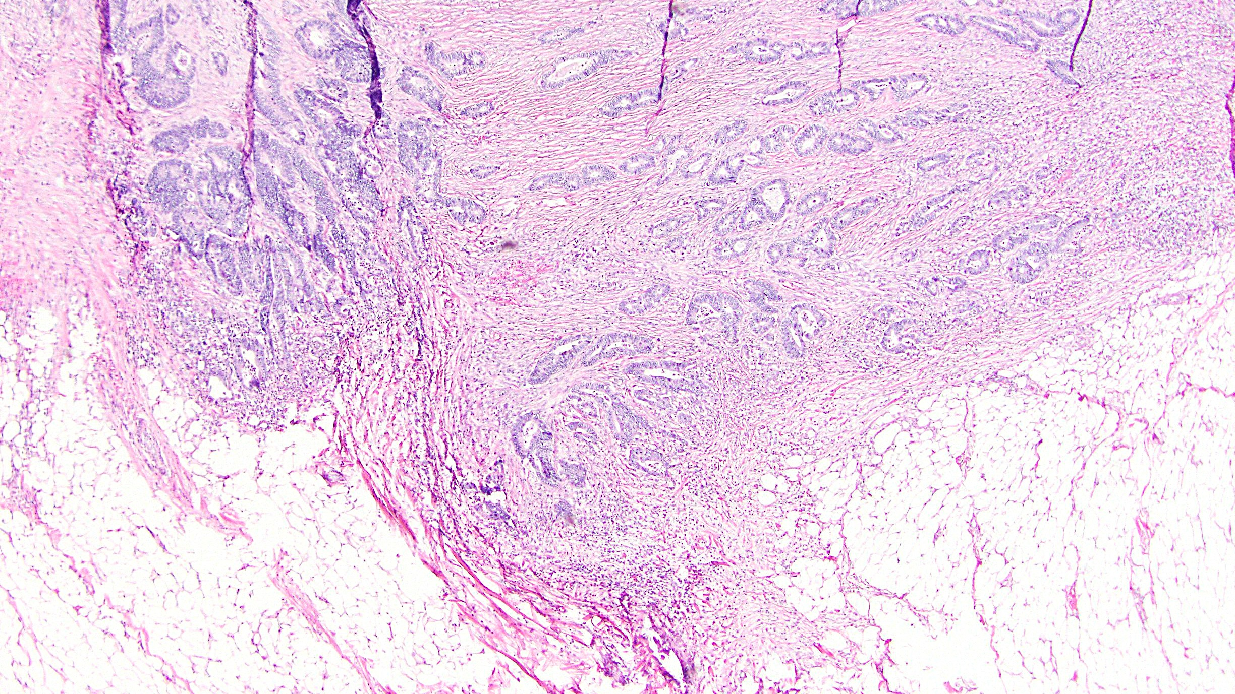
Obvious pT3

Slide 13
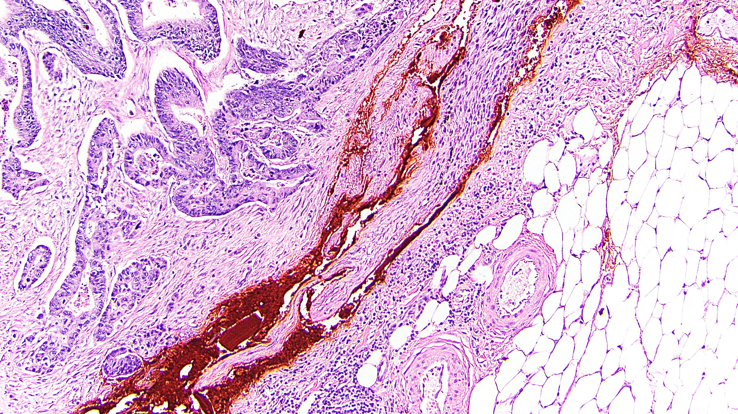
Obvious pT4

Slide 14
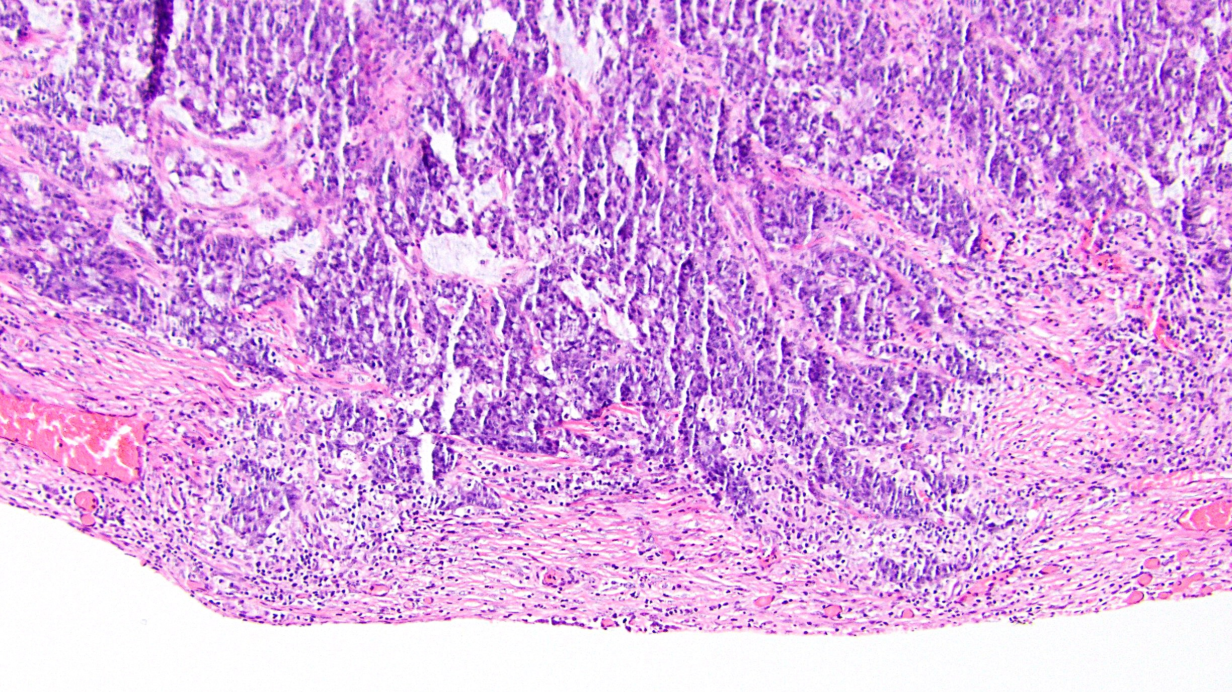
Now What?

Slide 15
Options for Evaluating Equivocal T3/T4 Disease
Additional levels or additional gross sections
CAP recommendation
Elastic stain
Highlights peritoneal elastic lamina – but does breach prove pT4a?
Recent study of 1202 CRC suggests pT3 with lamina breach have worse outcome (Kojima et al)
Touch prep of serosal surface
Panarelli et al: 46% of CRC with tumor < 1mm from serosa had tumor cells on touch prep
Just call it pT4!

Slide 16
Does Subdividing pT3 Have Significance?
Shepherd et al, 1997 (n=412): True peritoneal involvement has distinctly worse outcome
Do not subdivide pT3 or keep expanded pT4
Panarelli et al, 2013 (n=120): Tumor ≤1 mm from serosa has higher rates of peritoneal mets
Subdivide pT3 or keep expanded pT4
Snaebjornsson et al, 2014 (n=889): Tumor close to peritoneum behaved like positive serosa
Subdivide pT3 or keep expanded pT4
Klaver et al, 2018 (n=159): Tumor ≤1 mm from the serosa did not behave like positive serosa
Do not subdivide pT3 or keep expanded pT4
Pantaleon Vasquez et al, 2020 (n=151): Tumor ≤1 mm from serosa behaved like positive serosa
Subdivide pT3 or keep expanded pT4
Zwanenburg et al, 2022 (n=189): Tumor distance from serosa impacts rate of peritoneal mets
Subdivide pT3 or keep expanded pT4
Ono et al, ongoing (n=244): Distance of tumor to serosa did not predict recurrence
Do not subdivide pT3 or keep expanded pT4

Slide 17
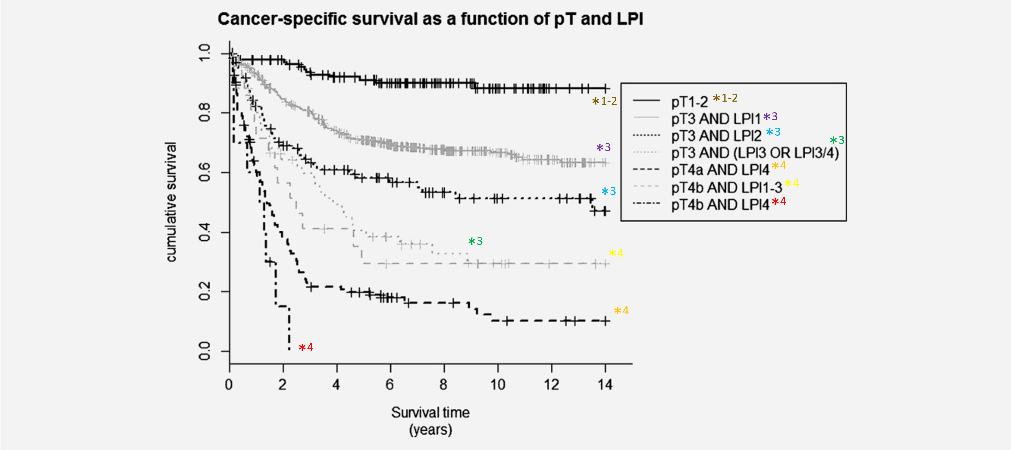
Splitting Hairs That Are Already Split
Snaebjornsson et al

Slide 18
Survey
H&E section from surgical resection of untreated colon cancer shows viable tumor that is >1 mm from the serosal surface but is continuous with the peritoneal surface through inflammation. How will you stage this tumor?
pT3: 49%
pT4: 51%

Slide 19
Case 2
A treated rectal carcinoma is resected, and there is residual tumor consisting of strips of malignant epithelium floating in large mucin pools. The deepest pool extends into the muscularis propria, but the malignant epithelial cells float in the upper part of the mucin pool, in the region of the submucosa.
Should this be staged as ypT1 or ypT2?

Slide 20
Neoadjuvant Therapy in Rectal Carcinoma
Advanced rectal cancer typically undergoes neoadjuvant therapy prior to resection
In cases with moderate response, some of the tumor dies off, leaving acellular or paucicellular mucin in its place
Should staging report where the tumor is? Where the tumor was? Where the tumor could be?

Slide 21
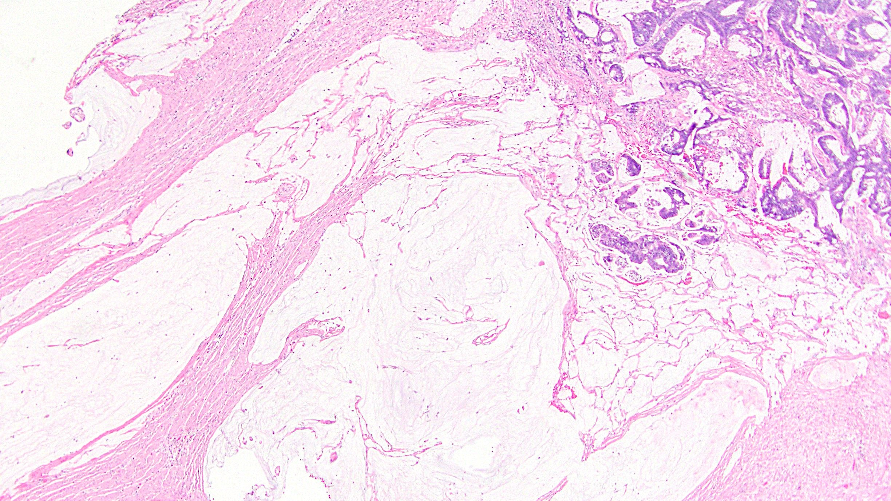
How Low Can You Go?

Slide 22
Survey
A neoadjuvant-treated rectal cancer consists of large mucin pools that dissect into muscle wall. Viable tumor cells (floating in mucin pools, marked by arrow) are only found in the submucosa, but the same mucin pools extends into the muscularis propria where they contain no epithelium. How would you stage this?
ypT1: 65%
ypT2: 35%

Slide 23
Case 3
An untreated colorectal carcinoma is resected, and none of the nodes show malignant epithelium. However, two nodes show acellular mucin, with no cells seen on levels or immunohistochemical stains.
Should this be staged as pN0 or pN1b?

Slide 24
Acellular Mucin, Sans Neoadjuvant Therapy
“Treated lymph nodes” with acellular mucin are not uncommon in rectal cancer following neoadjuvant therapy
Rarely, they can be seen in the absence of presurgical treatment
CAP and AJCC: no recommendation
UICC: positive for carcinoma

Slide 25
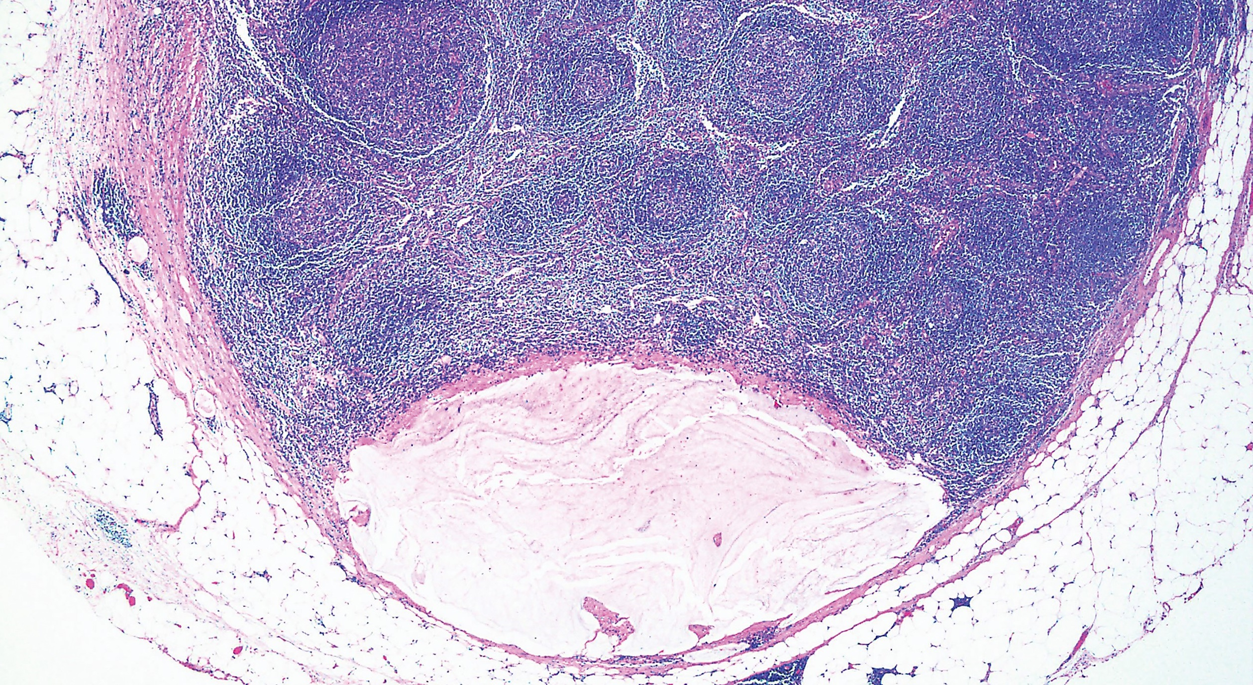
No Neoadjuvant Therapy

Slide 26
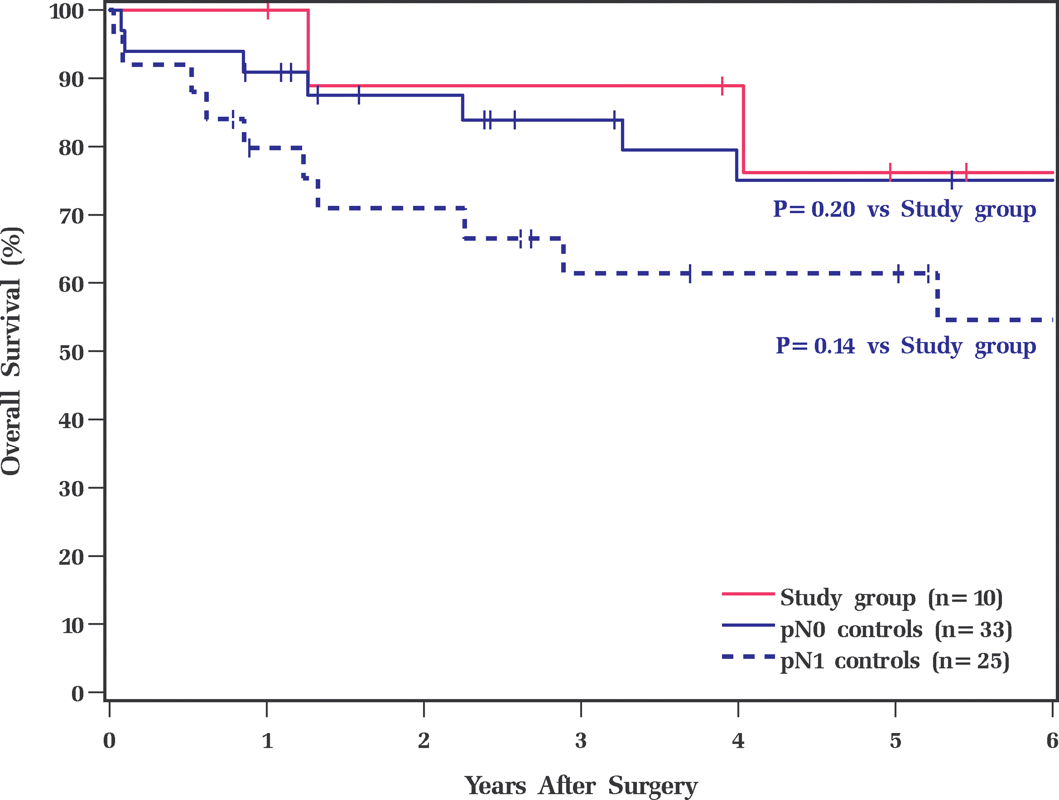
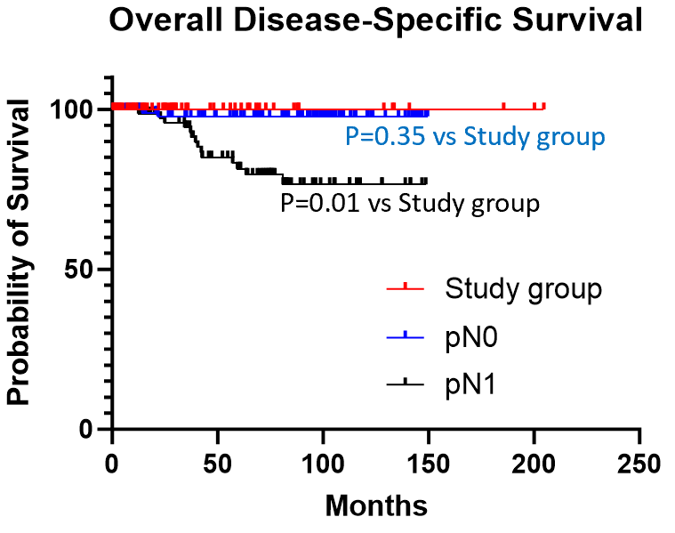
Acellular Mucin, Sans Neoadjuvant Therapy
Lapinski et al
Recent studies indicate this is almost exclusively seen in MMR-deficient CRC and does not indicate poor prognosis
Therefore, behaves like pN0
Luo et al

Slide 27
Survey
Left hemicolectomy of an untreated colonic carcinoma … 2 of 35 lymph nodes show acellular mucin with no viable tumor cells (despite multiple deeper levels). How would you stage this?
pN0: 67%
pN1b: 33%

Slide 28
Case 4
An untreated colorectal carcinoma is resected, and none of the nodes show malignant glands. However, one node shows rare malignant-appearing cells that are keratin-positive on IHC. The foci are easily smaller than 0.2 mm.
Should this lymph node be reported as positive or negative?

Slide 29
Isolated Tumor Cells
AJCC: single tumor cells or small clusters of tumor cells in lymph nodes, less than 0.2 mm
pN0(i+)
This does not exist in colon cancer staging, though AJCC discusses it
May be occult (visible on keratin IHC but not on H&E)

Slide 30
Isolated Tumor Cells
Published studies have used varied size cutoffs, definitions, and terminology
Micrometastases = 0.2 mm to 2 mm in size
May be more important in pT3 and pT4 cases
Reportedly present in up to half of pN0 colon cancers
Faerden et al, 2011 (n=193): ITC and micromets are prognostic
Protic et al, 2015 (n=203): ITC indicate worse DFS
Weixler et al, 2016 (n=74): ITC indicate worse DFS and OS

Slide 31
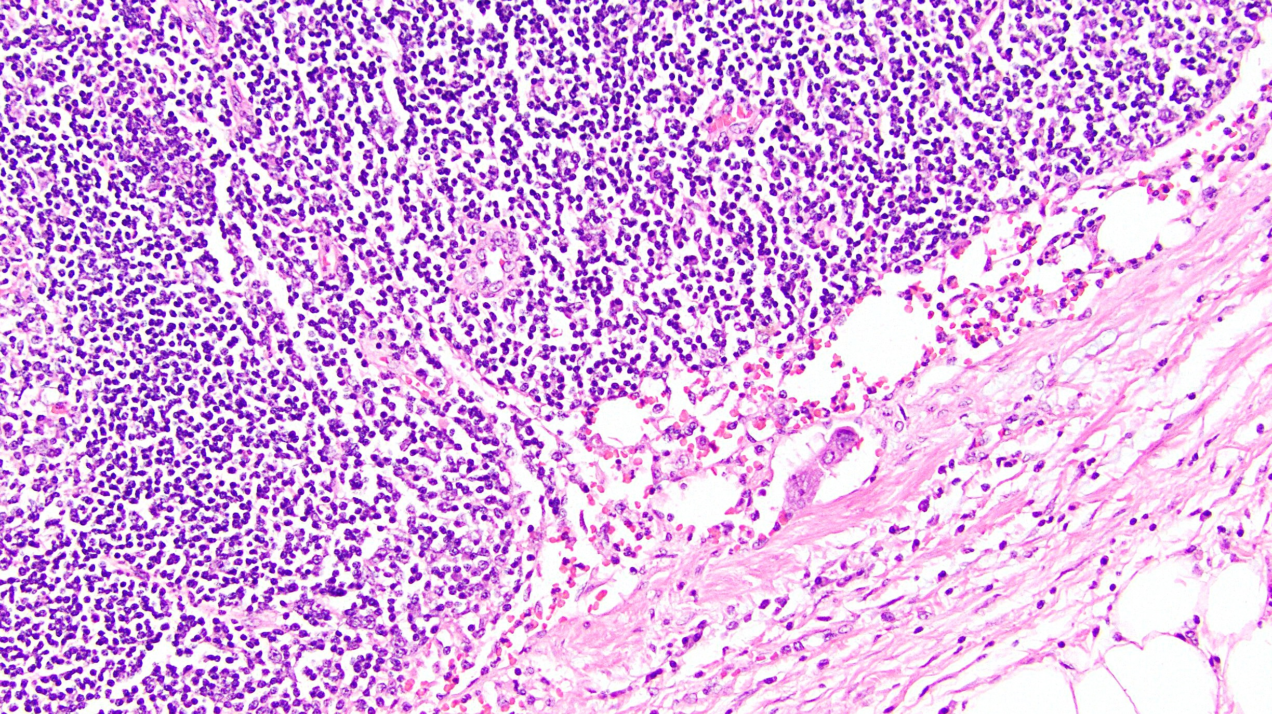
Blink and You’ll Miss Them

Slide 32
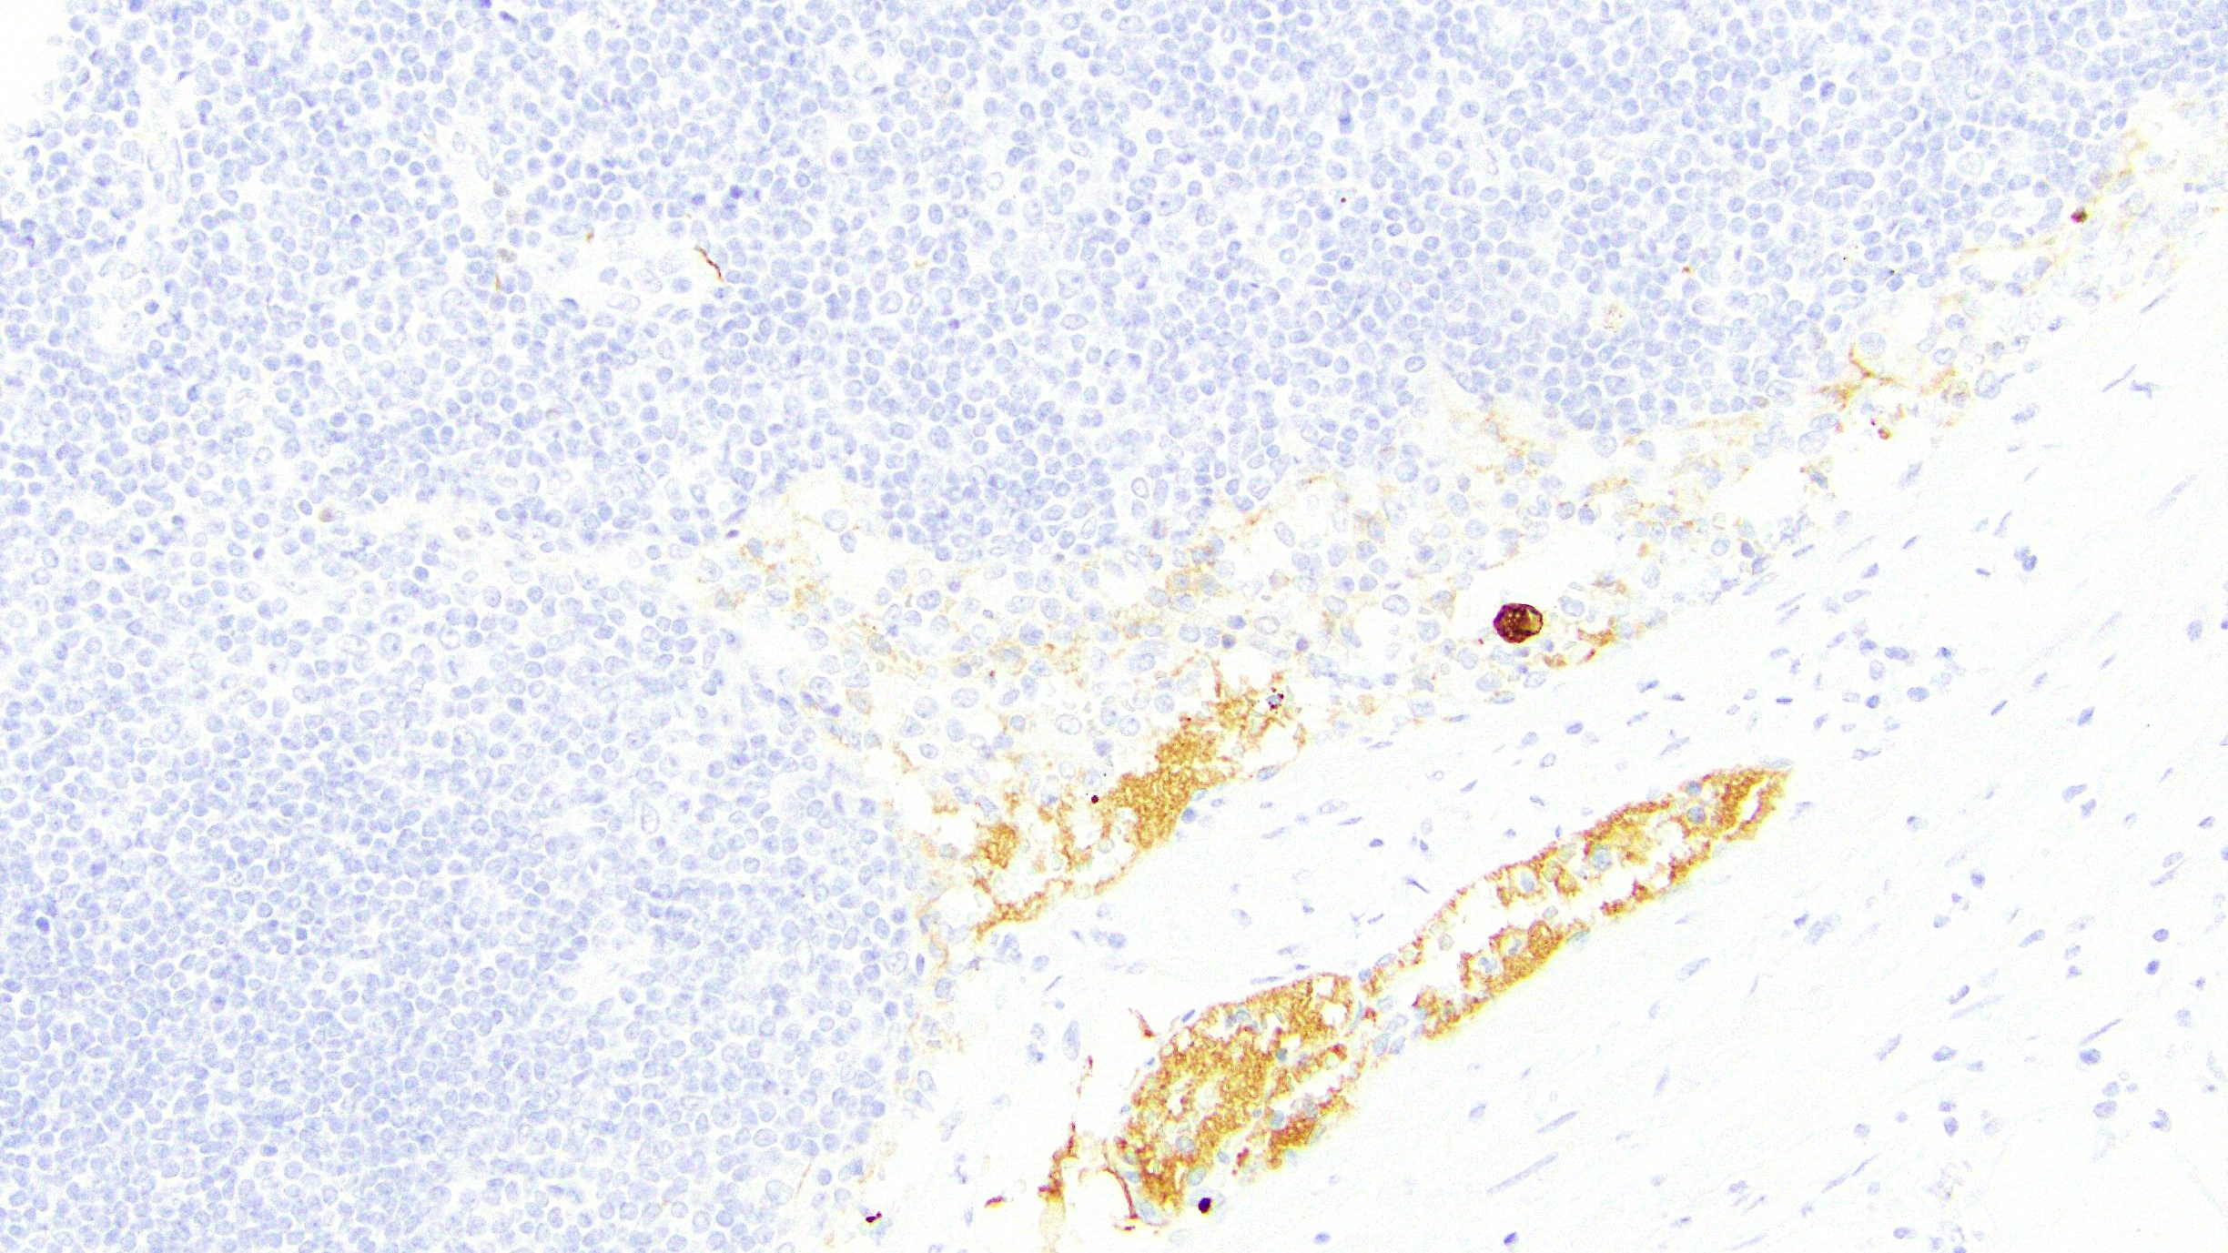
Keratin IHC to Confirm

Slide 33
Survey
Left hemicolectomy of an untreated colonic carcinoma … one of 40 lymph nodes show tumor cells measuring <0.2 mm. How do you stage this?
Negative lymph node: 5%
Negative lymph node (with isolated tumor cells): 47%
Positive lymph node: 48%

Slide 34
Additional Challenges in N-Category Staging
Sufficient number of lymph nodes
Tumor deposits

Slide 35
More Lymph Nodes, Please
General minimum consensus standard is 12 nodes
AJCC, ACS, NQF, etc.
Various studies have suggested from 7 to 17 nodes
Small nodes can be easily missed grossly but still contain metastasis
Some studies have indicated poor survival in patients with fewer reported nodes
Are we missing metastases?
Or do these patients have decreased immune response?
Oncologist may not trust the accuracy if < 12 LNs reported – chemo?
Options: clearing solutions, tossing in fat, apologetic comment

Slide 36
Tumor Deposits … What, Where, Why
Discrete, discontinuous focus of carcinoma separate from the primary mass, located in the subserosa, mesentery, or nonperitonealized pericolic or perirectal/mesorectal tissue
Does not represent lymph node involvement, lymphovascular invasion, perineural invasion, or direct tumor spread
Landau et al, study of 150 stage 3 CRC:
Patients with TDs have worse disease-specific survival than patients with 0-3 positive LNs (P<0.001 for 0; P=0.02 for 1-3)
Patients with TDs have a 2.2-fold risk of disease recurrence (P=0.02)

Slide 37
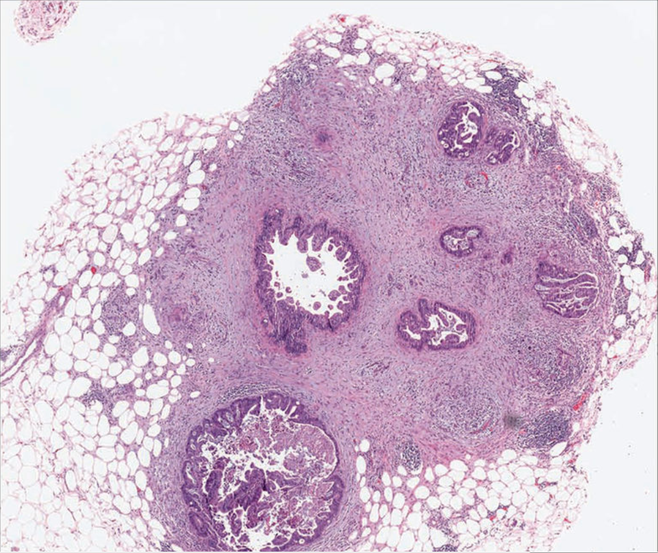
Rock et al

Slide 38
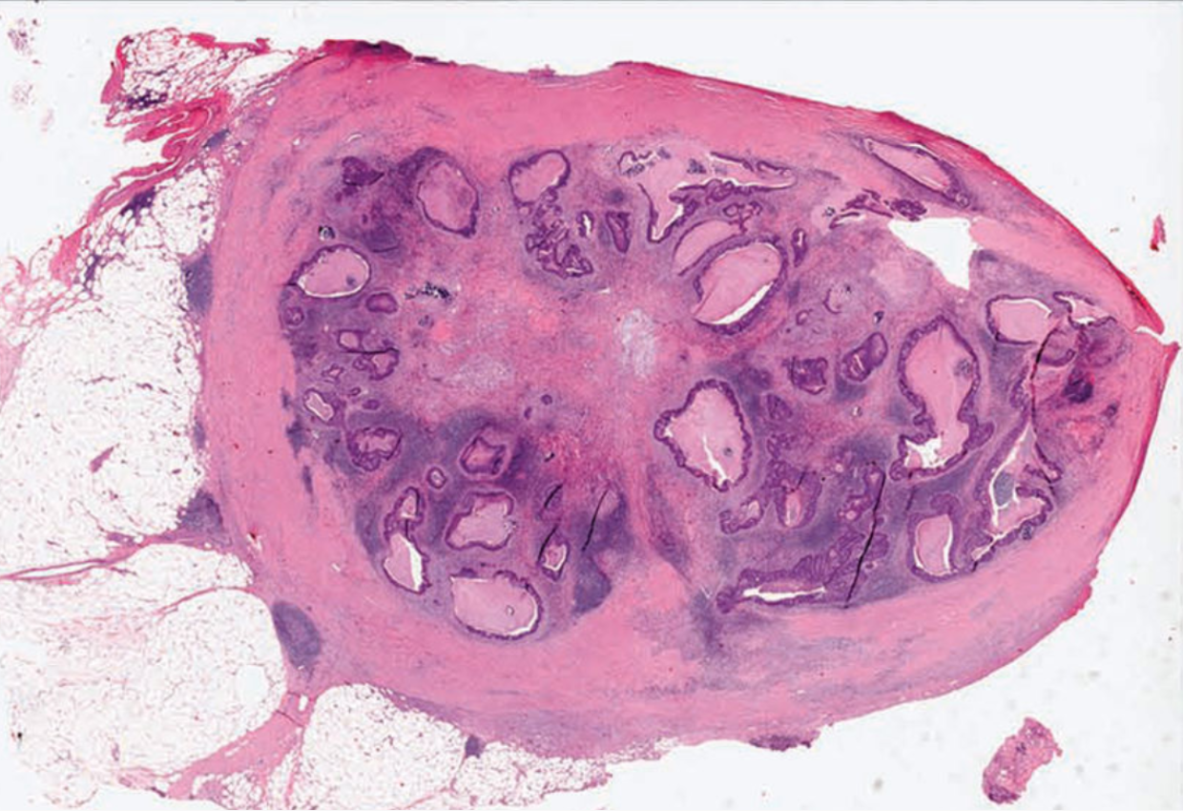
Rock et al

Slide 39
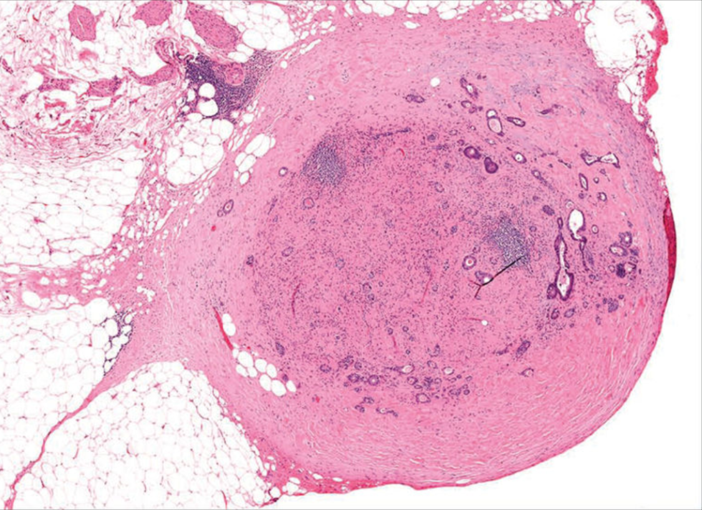
Rock et al

Slide 40
Expert (Dis)agreement in Diagnosing TDs
Rock et al: 25 tumor foci were circulated among 7 gastrointestinal pathologists
Complete agreement was found for 11: 5 LNs and 6 TDs
7 of 7 called this a TD

Slide 41
Expert (Dis)agreement in Diagnosing TDs
Diagnostic criteria most often utilized: round shape, thick capsule, peripheral lymphoid follicles, peripheral rim of lymphocytes, > 3mm
6 of 7 called this a LN
4 of 7 called this a TD

Slide 42
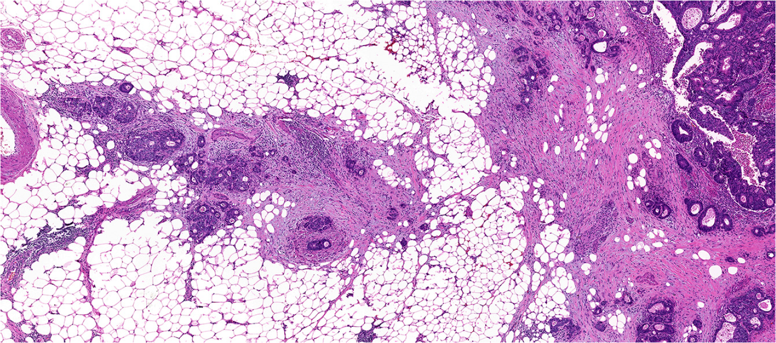
No Distance Cutoff (But 2 mm Seems OK)
Jin et al

Slide 43
Other Challenges in Synoptic Reporting
Tumor grading
Tumor budding
LVI

Slide 44
Tumor Grading
AJCC 8th edition: four-tier grading system
G1, well differentiated (>95% gland formation)
G2, moderately differentiated (50-95% gland formation)
G3, poorly differentiated (<50% gland formation)
G4, undifferentiated (no gland formation)
WHO 2019: low-grade (formerly WD and MD) or high-grade (formerly PD), based on gland formation in the least differentiated component, ignoring invasive front
Some colorectal carcinoma subtypes have an “intrinsic grade”
SRC and micropapillary effectively high-grade, for instance
Medullary looks high-grade but behaves low-grade

Slide 45
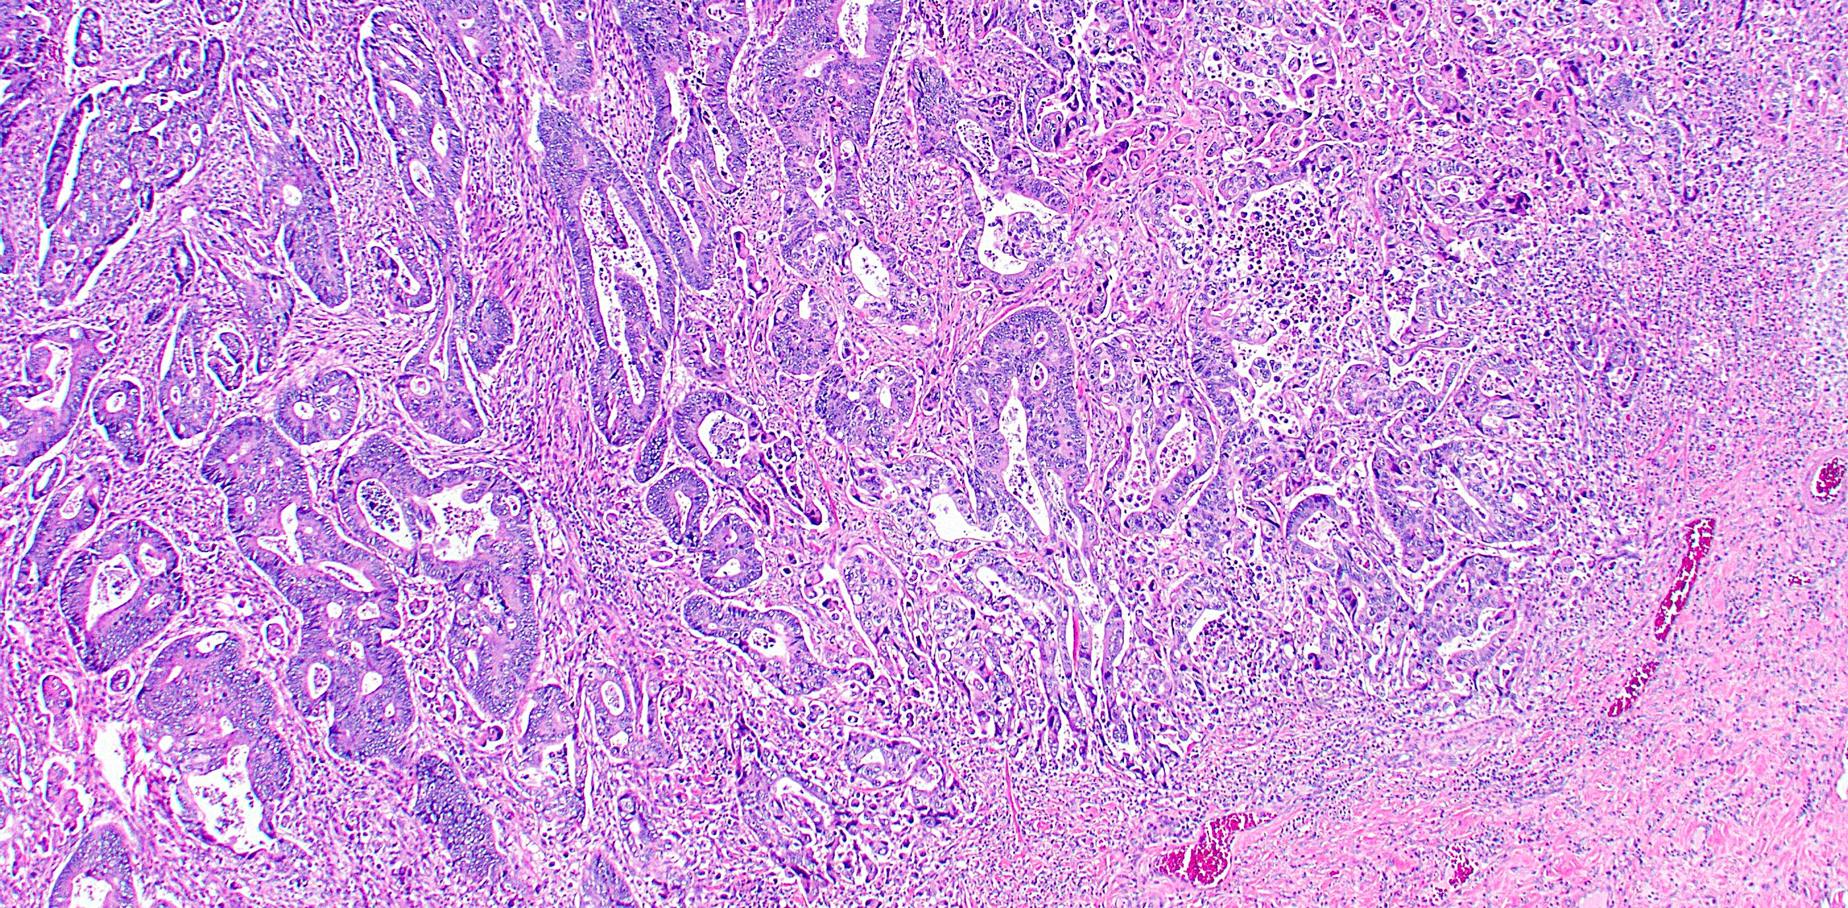
Does This Make The Grade?

Slide 46
Tumor Budding
Small clusters of cells at invasive edge of malignancy
ITBCC 2016: A single tumor cell or a cell cluster of up to 4 tumor cells
Recognized for decades as potentially prognostically significant
May also indicate epithelial-mesenchymal transition
Independent predictor of lymph node metastasis in pT1 CRC
Independent predictor of survival in stage II CRC
Related but separate issue: poorly differentiated clusters

Slide 47
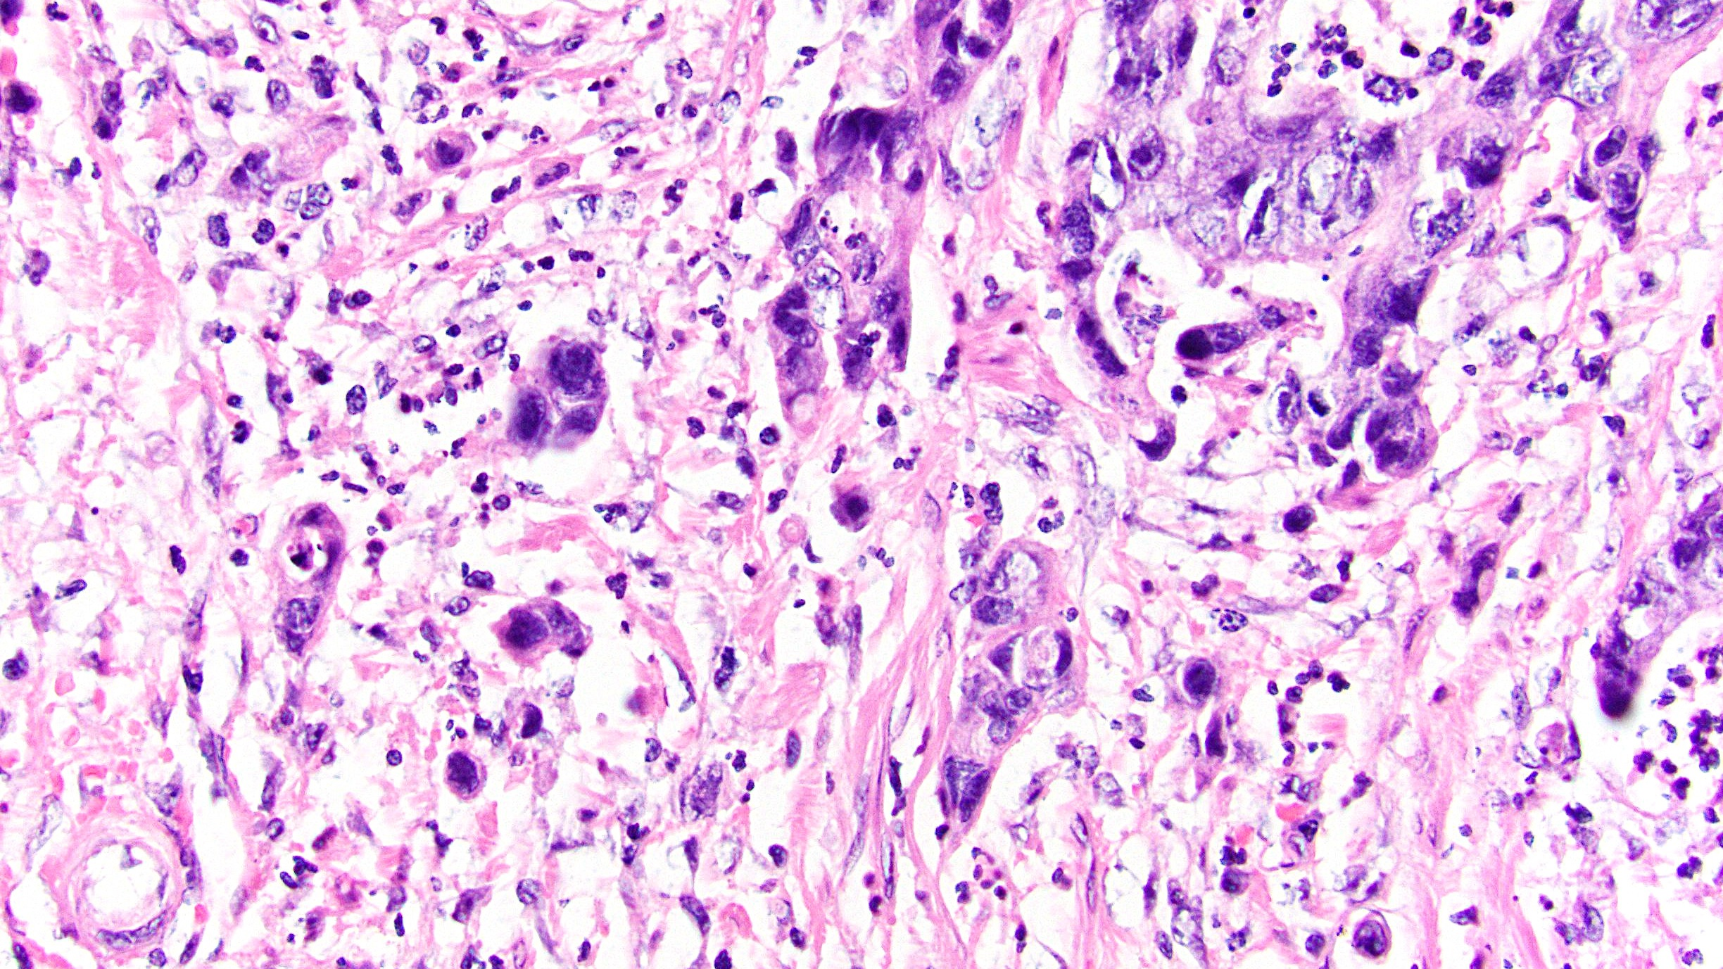
What Counts as a Bud?

Slide 48
How To Count Tumor Buds
1. Pick H&E (not IHC) slide with greatest tumor budding
2. Scan at 10x to find hottest spot (10 fields recommended)
3. Count tumor buds in hotspot at 20x
4. Correct for count using normalization factor (Lugli et al)
Do we have to do this? Recent study suggests no (Cyr et al)
5. Report as:
Bd1 (0-4 buds per 0.785 mm²)
Bd2 (5-9 buds per 0.785 mm²)
Bd3 (>10 buds per 0.785 mm²)

Slide 49
The Many Flavors of LVI
Small vessel invasion: tumor involving thin-walled structures lined by endothelium, without an identifiable smooth muscle layer or elastic lamina
Lymphatics, capillaries, postcapillary venules
Venous (large vessel) invasion: tumor involving endothelium-lined spaces with an identifiable smooth muscle layer or elastic lamina
Various methods can help improve detection
Some studies have conflated these, but significance may differ
Large vessel definitely an adverse indicator; small vessel probably also
Extramural likely worse than intramural, for both

Slide 50
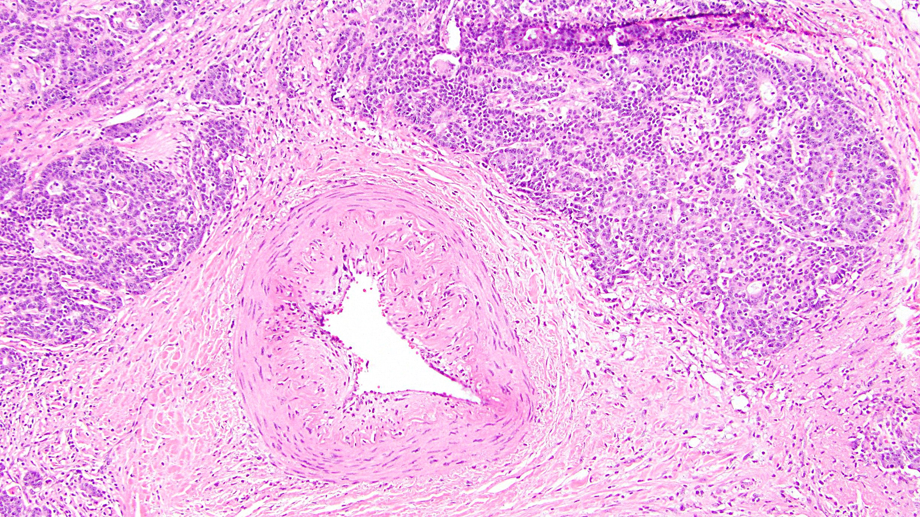
Orphan Artery

Slide 51
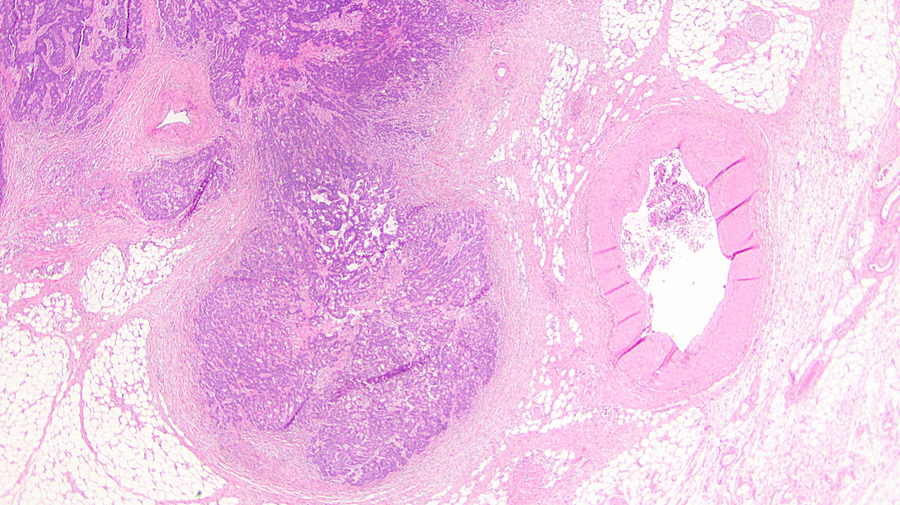
Protruding Tongue Sign

Slide 52
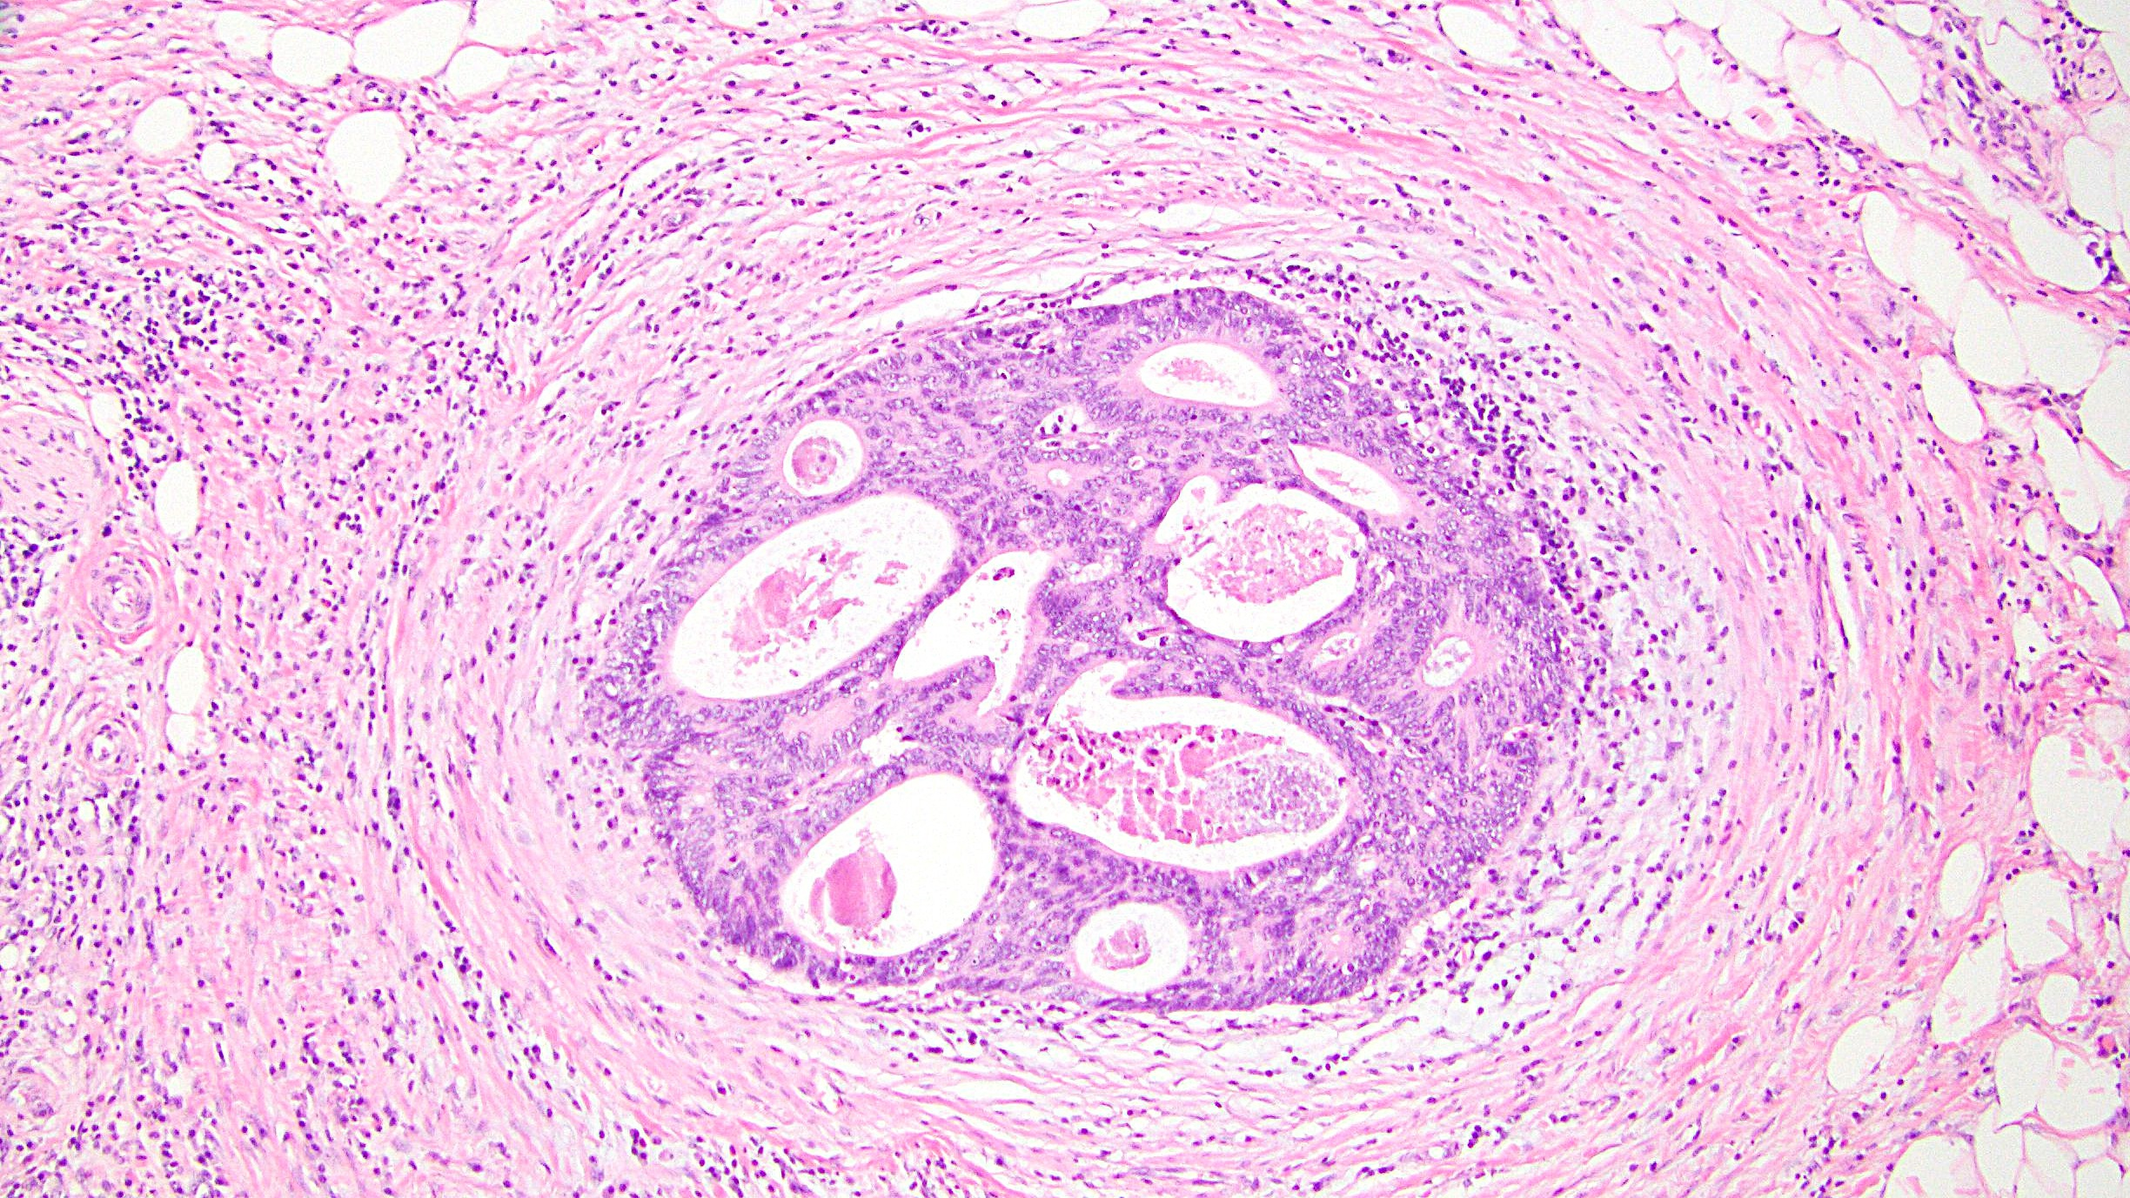
Maybe,
Maybe Not

Slide 53
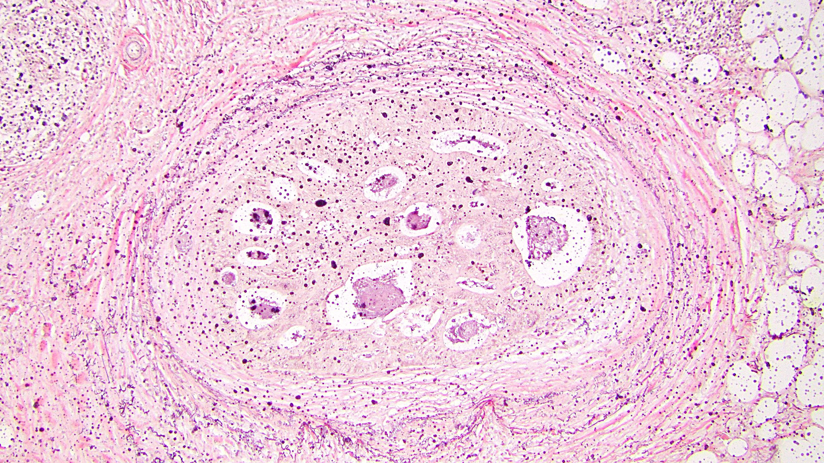
Elastin to the Rescue
(Order Up Front?)

Slide 54
References
Burgart LJ, et al. Protocol for the Examination of Resection Specimens From Patients With Primary Carcinoma of the Colon and Rectum. https://documents.cap.org/protocols/cp-gilower-colonrectum-resection-20-4100.pdf
Clark I, et al. Current Challenges and Controversies in Colorectal Carcinoma Pathologic Staging-A Practical Guide. Adv Anat Pathol. 2024;31:43-51.
Cyr DP, et al. Tumor Budding Assessment in Colorectal Carcinoma: Normalization Revisited. Am J Surg Pathol. 2024 Mar 1 [Epub].
Dawson H, et al. A Review of Current Challenges in Colorectal Cancer Reporting. Arch Pathol Lab Med. 2019;143:869-882.
Faerden AE, et al. Lymph node micrometastases and isolated tumor cells influence survival in stage I and II colon cancer. Dis Colon Rectum. 2011;54:200-206.
Jessup JM, et al. “Colon and Rectum.” In: Amin MB, et al [Eds.]. AJCC Cancer Staging Manual. 8th ed. New York, NY: Springer; 2017. p. 251-274.
Jin M, et al. Lymph Node Metastasis in Colorectal Cancer. Surg Oncol Clin N Am. 2018;27:401-412.
Klaver CEL, et al. Locally Advanced Colorectal Cancer: True Peritoneal Tumor Penetration is Associated with Peritoneal Metastases. Ann Surg Oncol. 2018;25:212-220.
Kojima M, et al. Assessment of Elastic Laminal Invasion Contributes to an Objective pT3 Subclassification in Colon Cancer. Am J Surg Pathol. 2023;47:1122-1133.
Landau MA, et al. Histopathological Predictors of Recurrence in Stage III Colon Cancer: Reappraisal of Tumor Deposits and Tumor Budding Using AJCC8 Criteria. Int J Surg Pathol. 2019;27:147-158.
Lapinski JE, et al. Acellular mucin in lymph nodes isolated from treatment-naïve colorectal cancer resections: a clinicopathologic analysis of 16 cases. Virchows Arch. 2022;481:63-72.
Lugli A, et al. Recommendations for reporting tumor budding in colorectal cancer based on the International Tumor Budding Consensus Conference (ITBCC) 2016. Mod Pathol. 2017;30:1299-1311.
Mescoli C, et al. High prevalence of isolated tumour cells in regional lymph nodes from pN0 colorectal cancer. J Clin Pathol. 2006;59:870-874.
Nagtegaal ID, et al. “Colorectal adenocarcinoma.” In: WHO Classification of Tumours Editorial Board [Eds.}. Who Classification of Tumours: Digestive System Tumours, 5th Edition. Lyon: IARC Press, 2019, p. 177-187.
Panarelli NC, et al. Histologic features and cytologic techniques that aid pathologic stage assessment of colonic adenocarcinoma. Am J Surg Pathol. 2013;37:1252-1258.
Pantaleon Vasquez R, et al. T3 versus T4a staging challenges in deeply invasive colonic adenocarcinomas and correlation with clinical outcomes. Mod Pathol. 2021;34:131-140.
Protic M, et al. Prognostic Effect of Ultra-Staging Node-Negative Colon Cancer Without Adjuvant Chemotherapy: A Prospective National Cancer Institute-Sponsored Clinical Trial. J Am Coll Surg. 2015;221:643-651.
Rock JB, et al. Debating deposits: an interobserver variability study of lymph nodes and pericolonic tumor deposits in colonic adenocarcinoma. Arch Pathol Lab Med. 2014;138:636-642.
Shepherd NA, et al. The prognostic importance of peritoneal involvement in colonic cancer: a prospective evaluation. Gastroenterology. 1997;112:1096-1102.
Snaebjornsson P, et al. pT4 stage II and III colon cancers carry the worst prognosis in a nationwide survival analysis. Shepherd's local peritoneal involvement revisited. Int J Cancer. 2014;135:467-478.
Stewart CJ, et al. Assessment of Serosal Invasion and Criteria for the Classification of Pathological (p) T4 Staging in Colorectal Carcinoma: Confusions, Controversies and Criticisms. Cancers (Basel). 2011;3:164-181.
Weixler B, et al. Isolated tumor cells in stage I & II colon cancer patients are associated with significantly worse disease-free and overall survival. BMC Cancer. 2016;16:106.
Zwanenburg ES, et al. The measured distance between tumor cells and the peritoneal surface predicts the risk of peritoneal metastases and offers an objective means to differentiate between pT3 and pT4a colon cancer. Mod Pathol. 2022;35:1991-2001.

Slide 55

Questions?

Slide 56
Thank You!

